Slide 1
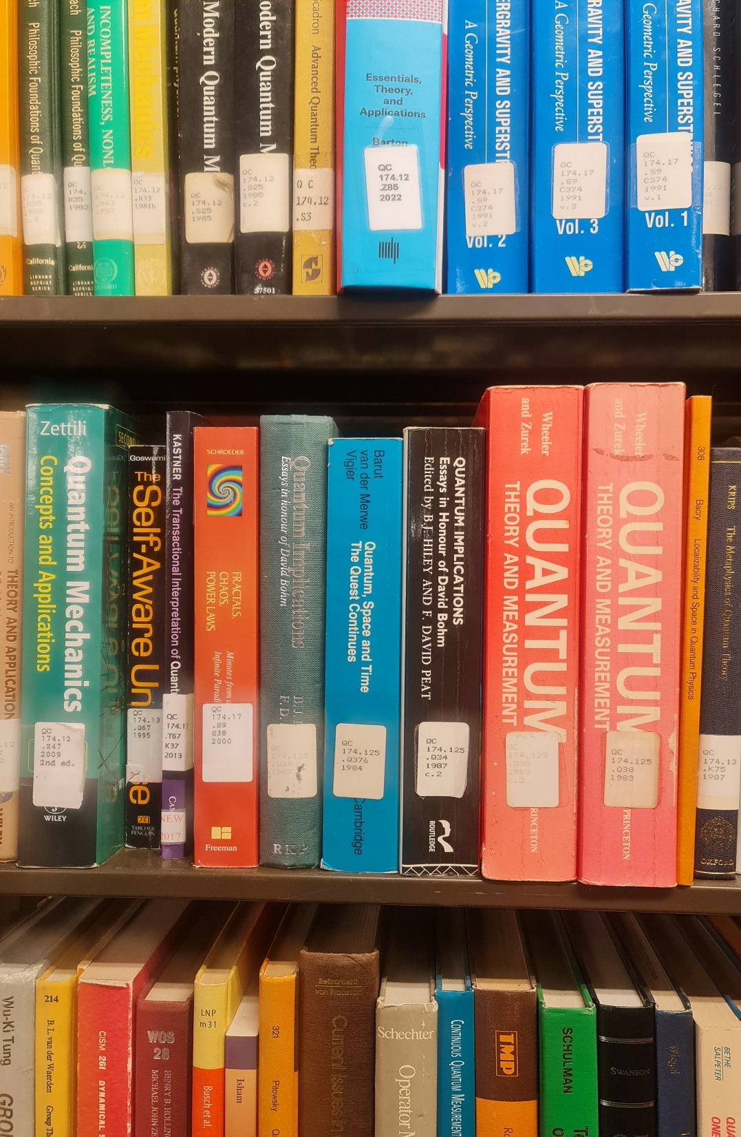
Library Management System v1.0.0
Team members:
Group 2
Hillary Arinda
Tonny Kakooza
Geoffrey Duncan Opiyo

Slide 2
STEPS WE TOOK
Software Development Life Cycle
Requirement Analysis
Static model
Dynamic model
Design, coding and testing
Notes:
Requirement analysis phase: Understanding the code in relation to the problem statement document given.
Static model: Developed the Use cases and class diagrams. Class was articulated after identifying various knowns and removing duplicates.
Dynamic model: This is where we transformed our static model into various sequence diagrams.
Design, coding and testing: We enhanced the static model and dynamic model using MVC. Then transformed designs into codes and vigorously did integration using Git, Github and testing.

Slide 3
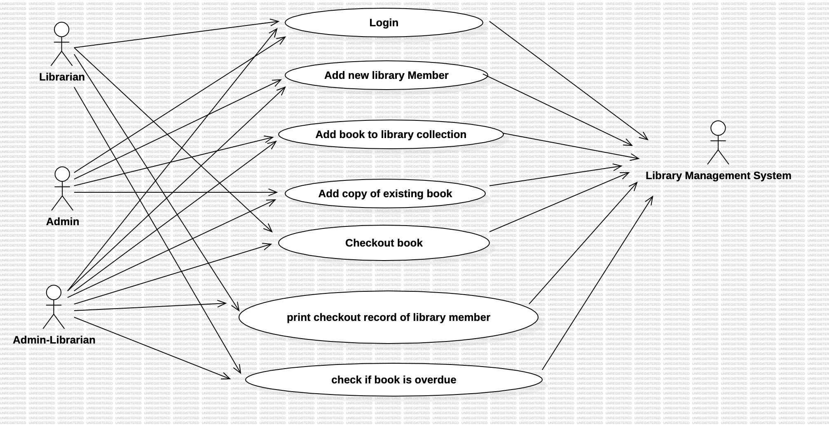

Slide 4
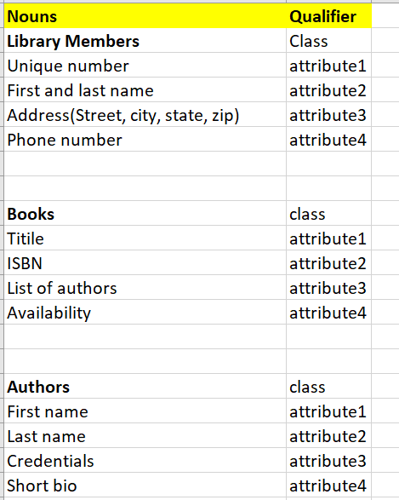
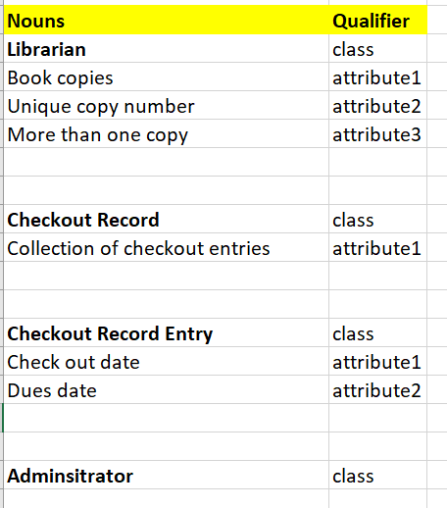

Slide 5
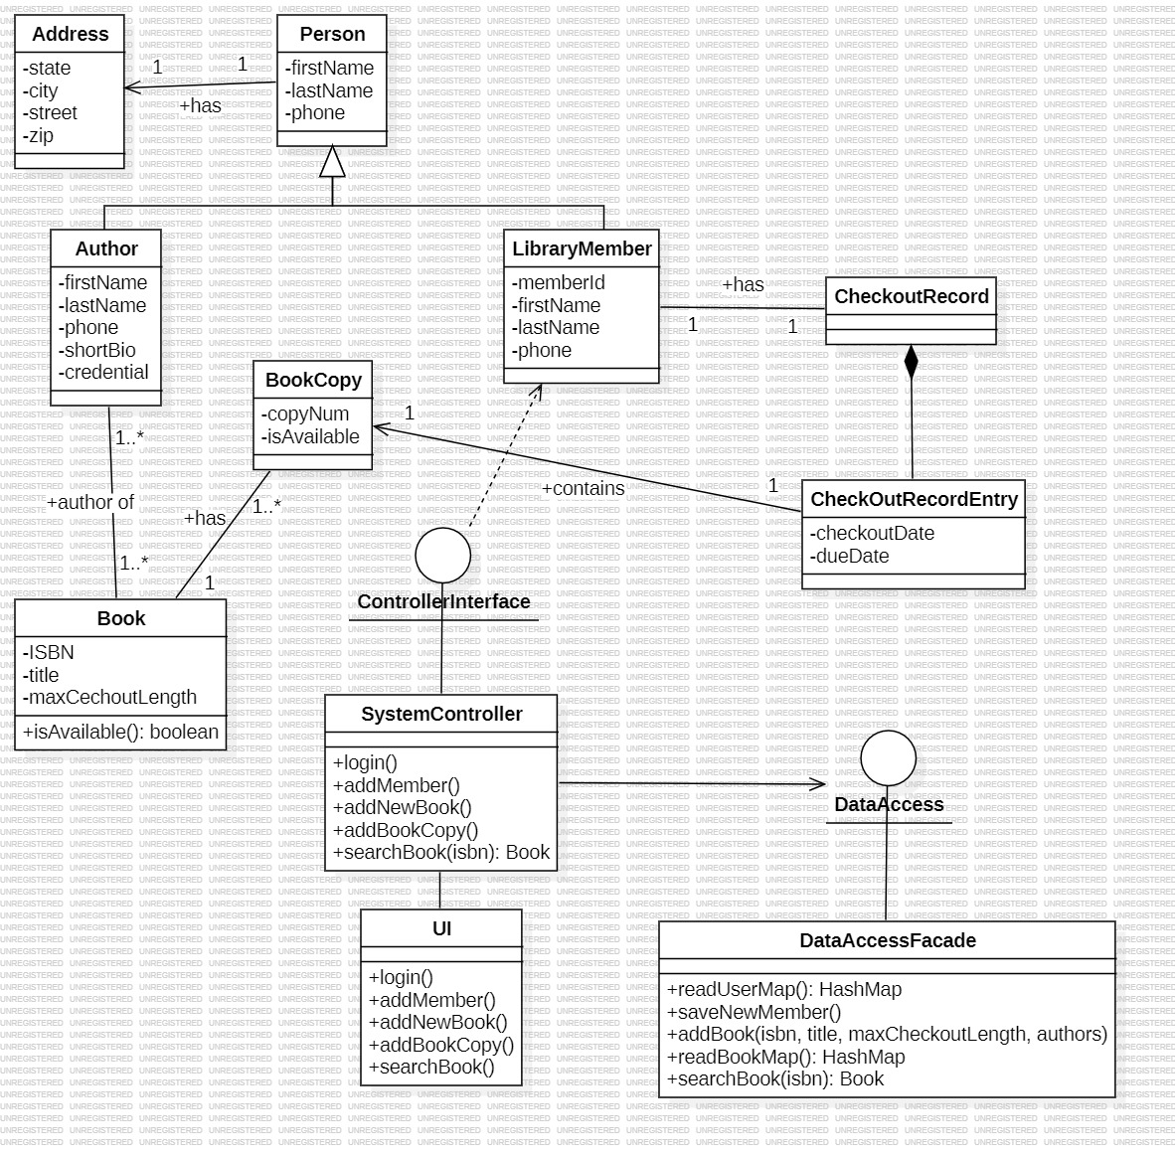
Notes:
We are following MVC Architecture, Objection Creation Factory Pattern and Singleton for UI states.

Slide 6
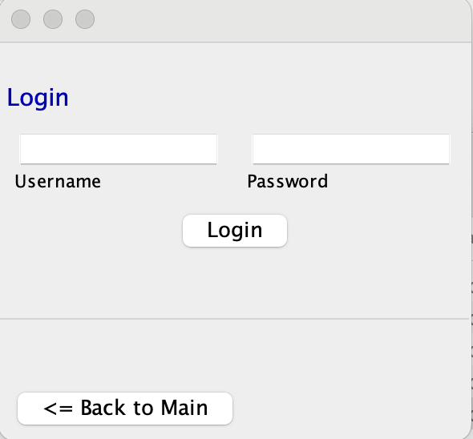

Slide 7
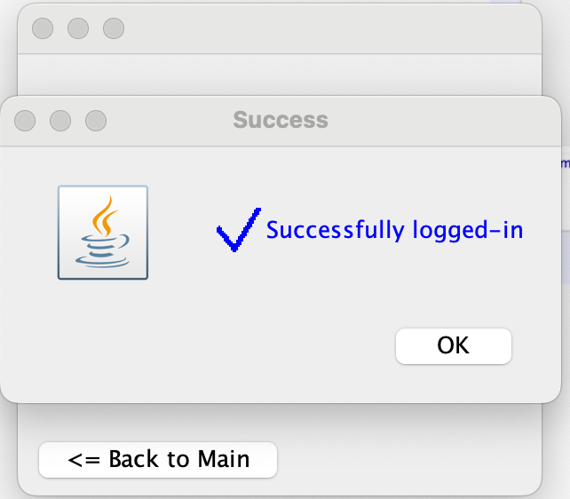

Slide 8
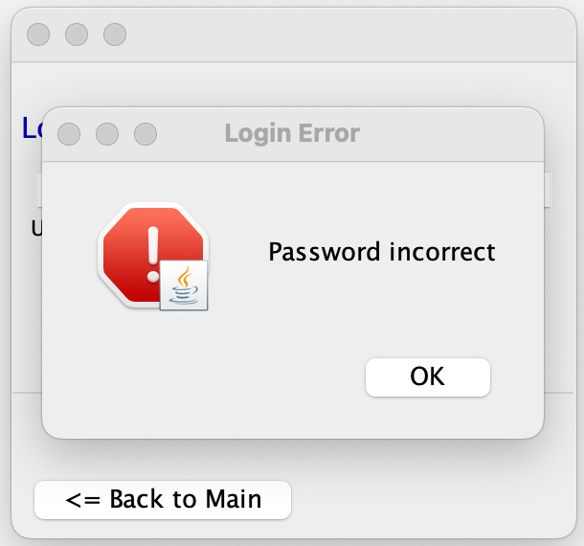

Slide 9
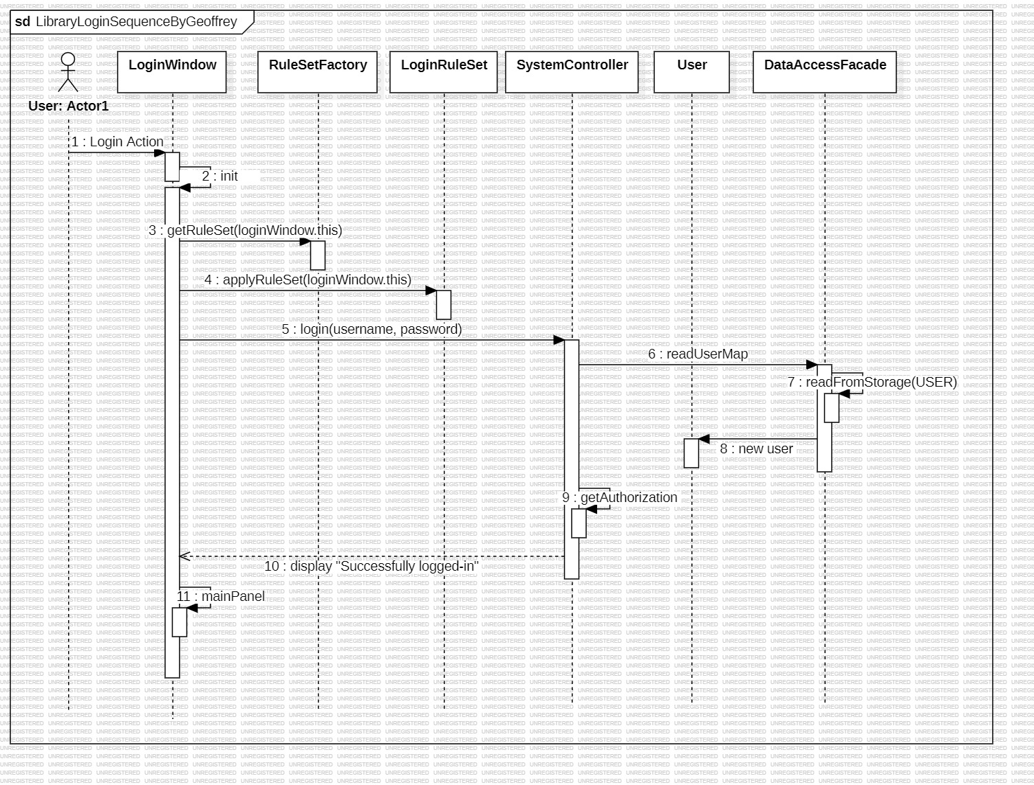
Notes:
Parameterized Objection Creation Factory Pattern.
All our UI classes are Singleton such that we maintain the same state of all UI windows throughout the life cycle of the application.

Slide 10
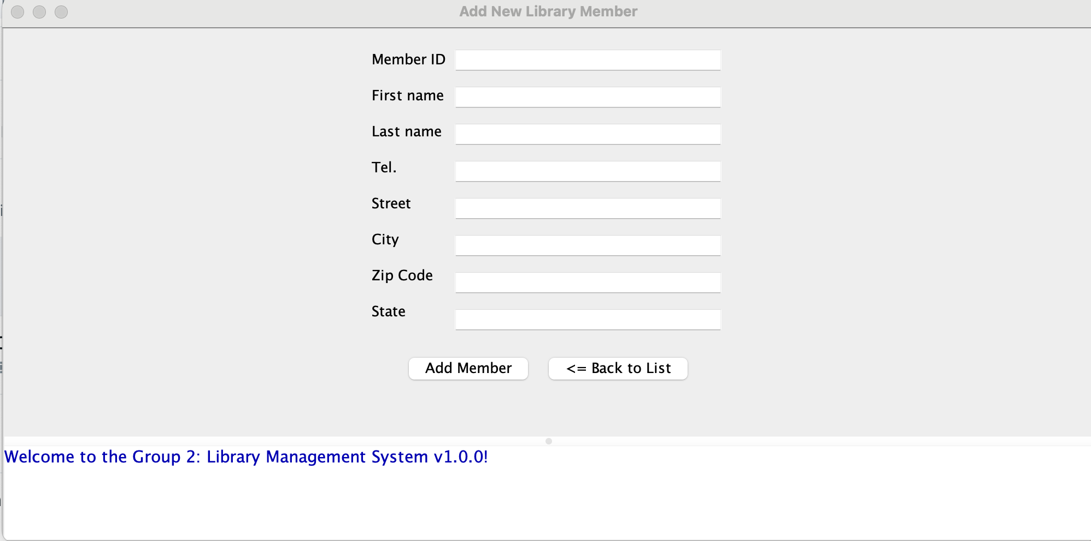

Slide 11
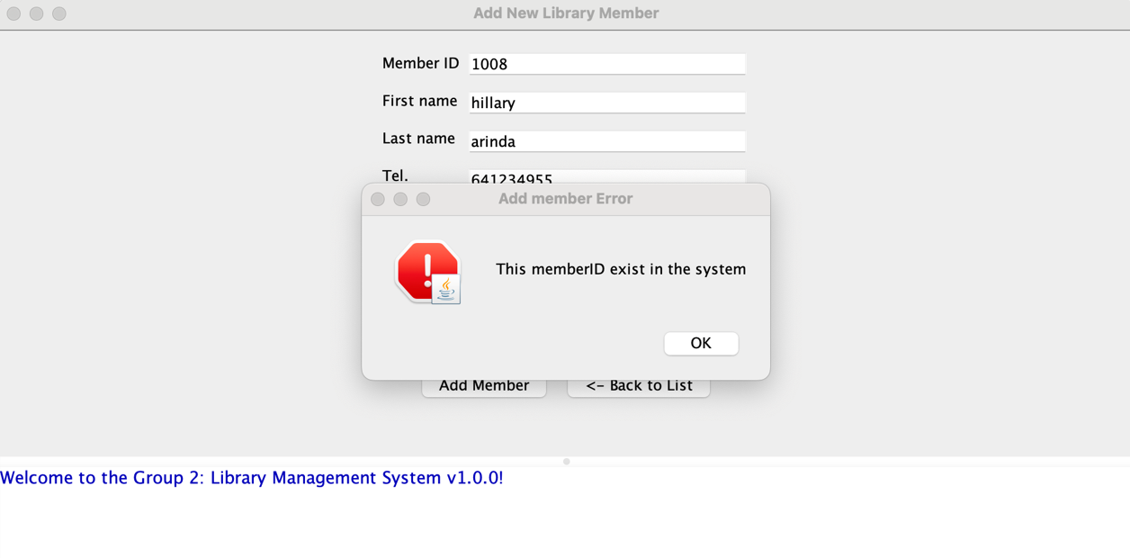

Slide 12
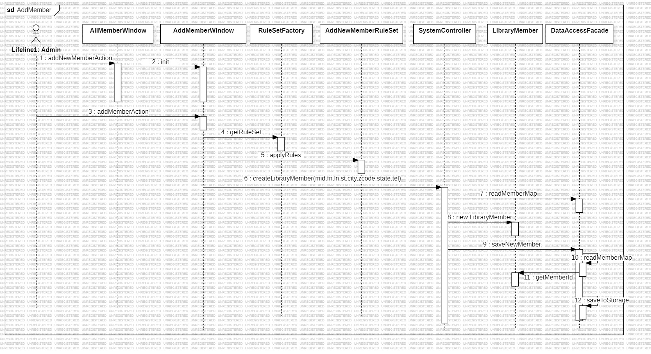
Notes:
Parameterized Objection Creation Factory Pattern.
All our UI classes are singleton such that we maintain the same state of all UI windows throughout the life cycle of the application.

Slide 13
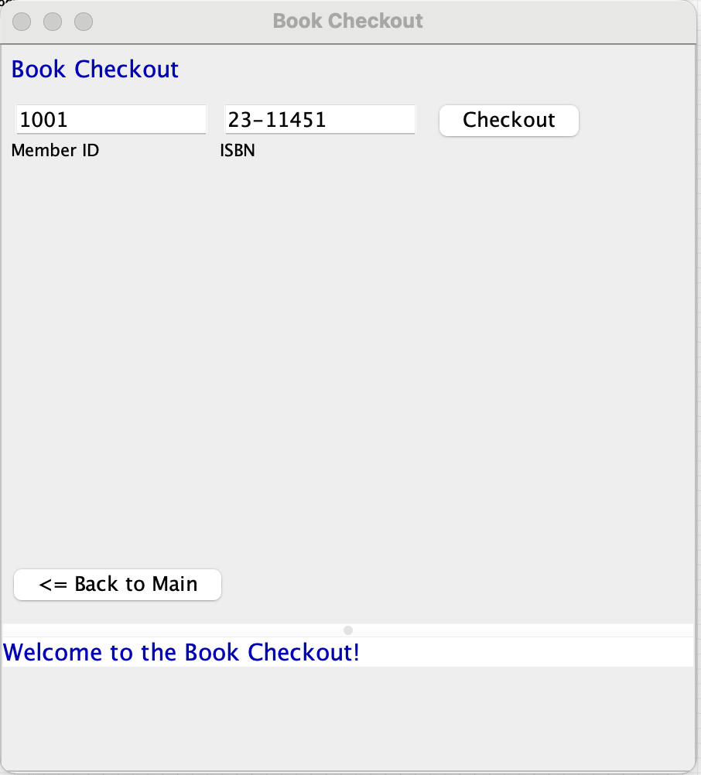

Slide 14
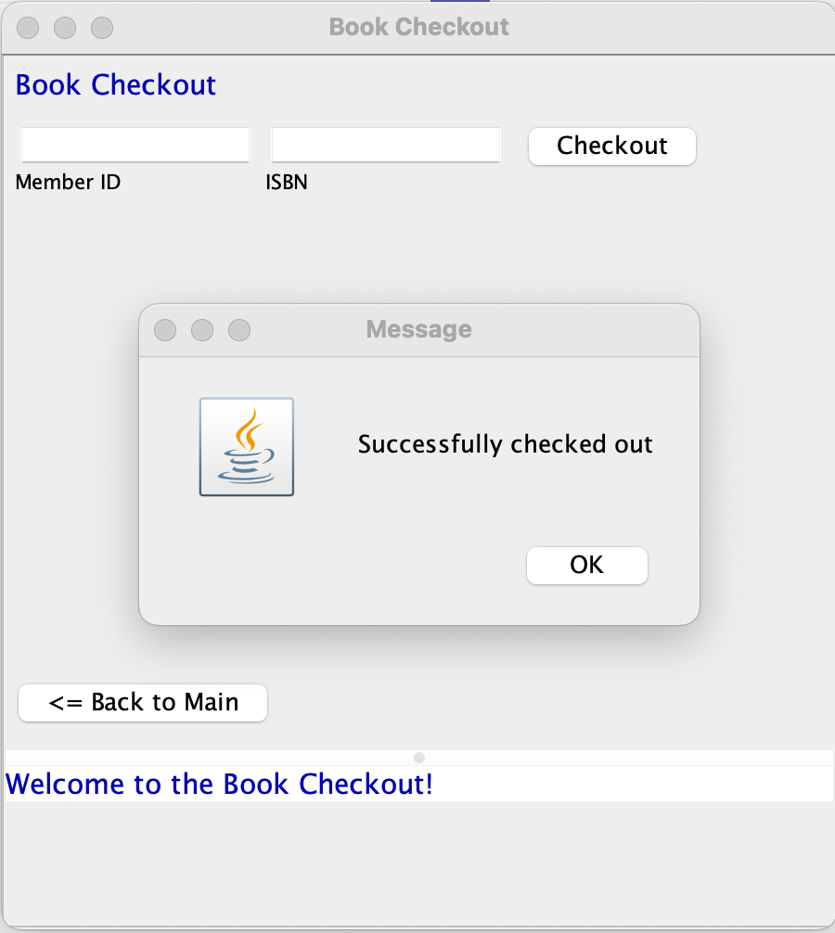

Slide 15
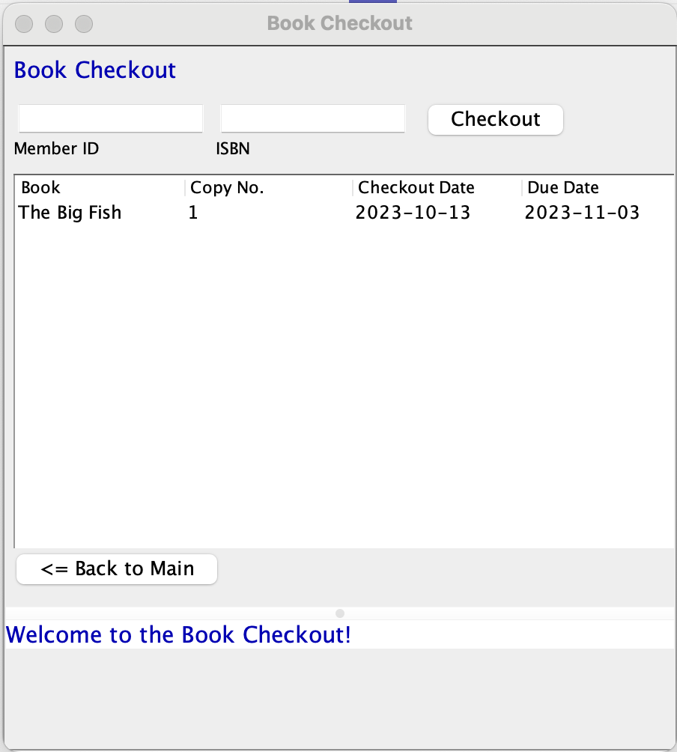

Slide 16
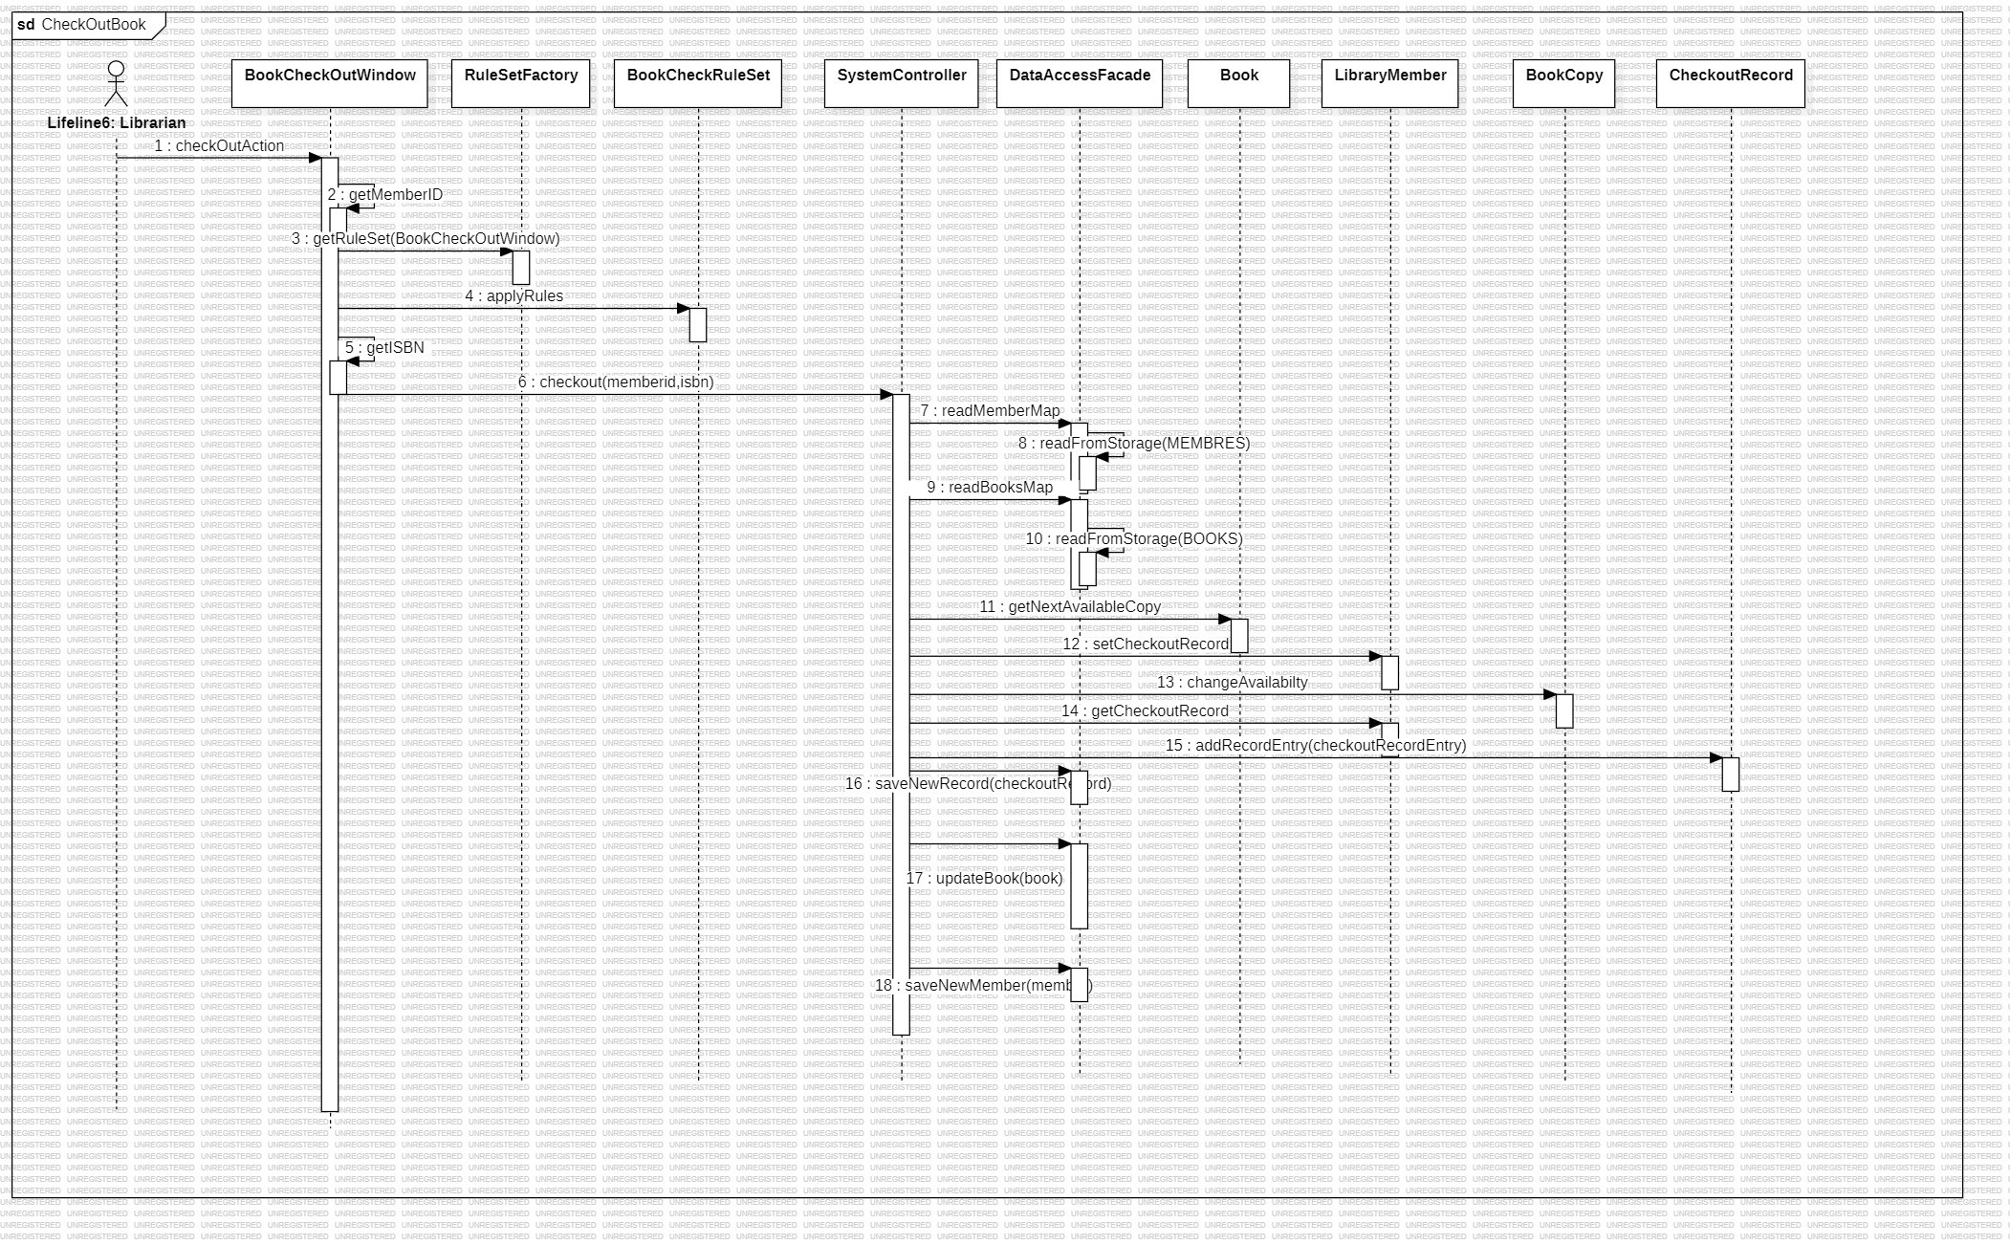
Notes:
Parameterized Objection Creation Factory Pattern.
All our UI classes are singleton such that we maintain the same state of all UI windows throughout the life cycle of the application.

Slide 17
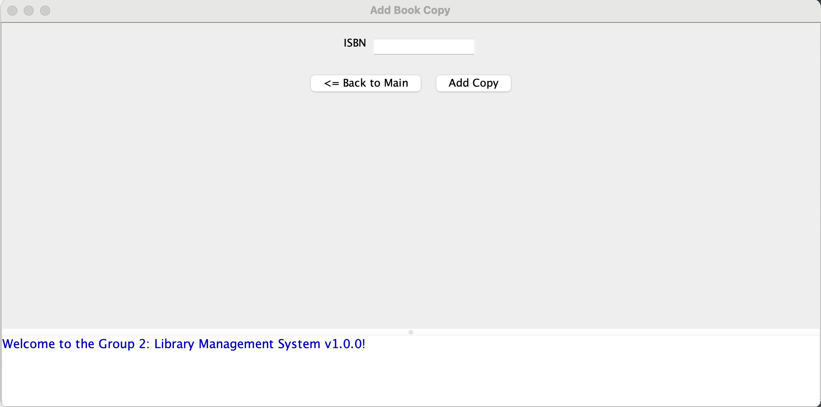

Slide 18
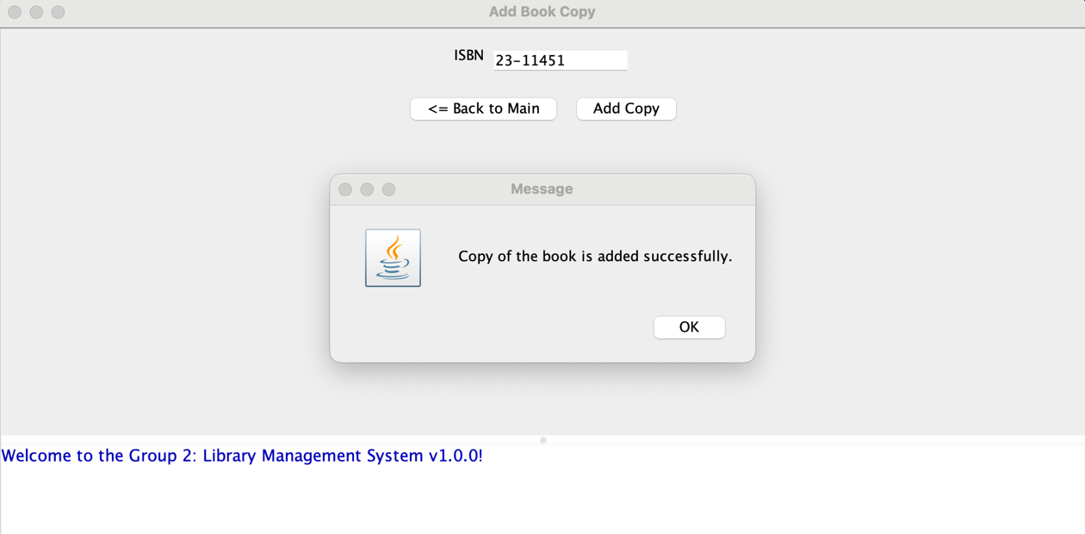

Slide 19
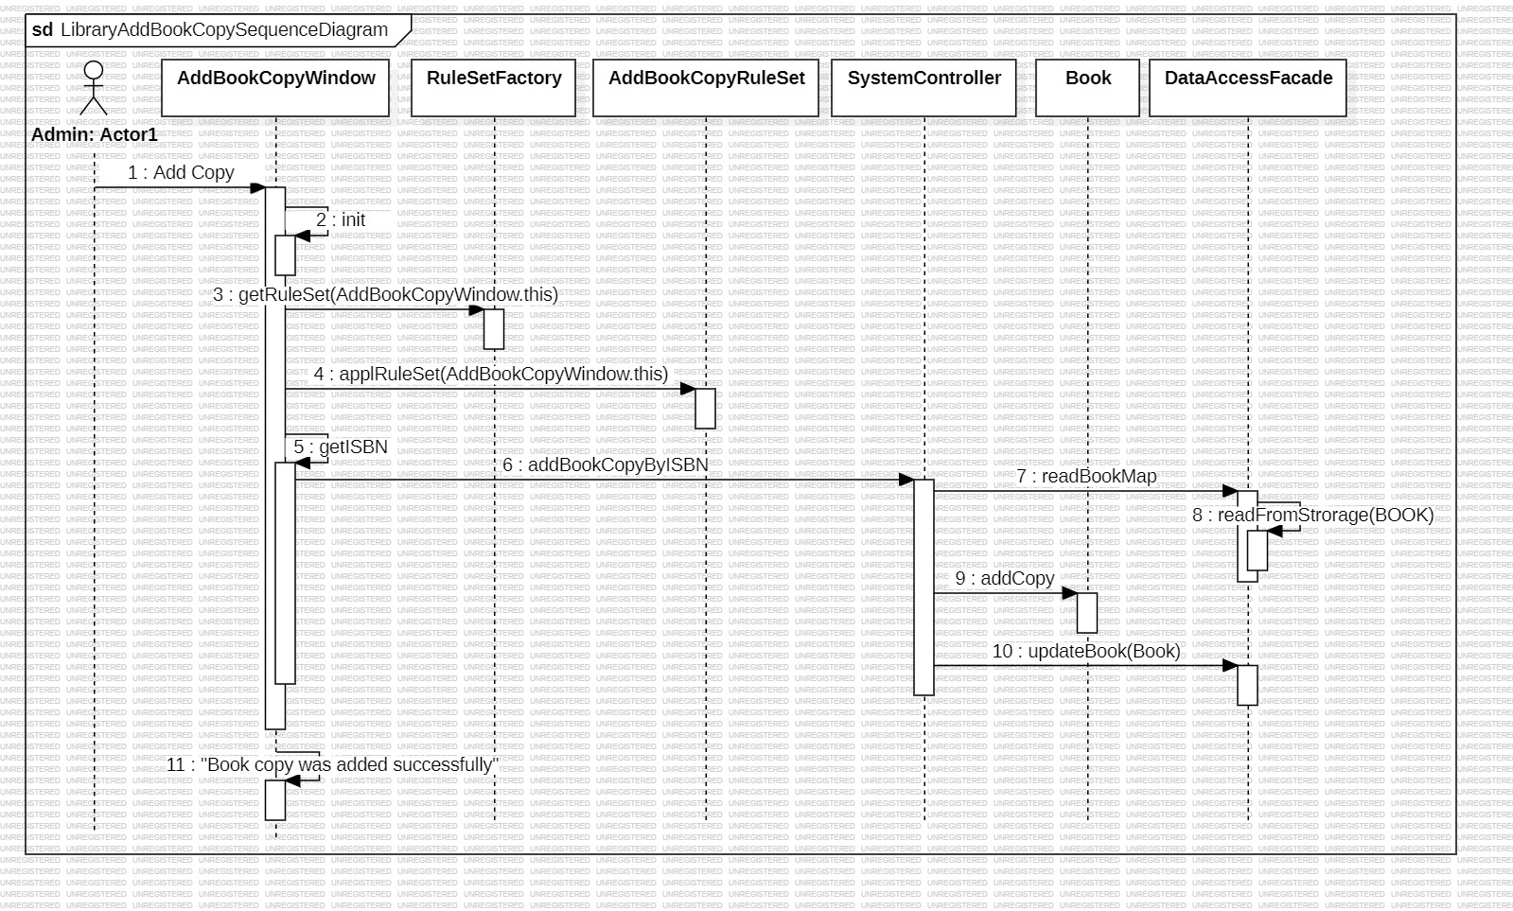

Slide 20
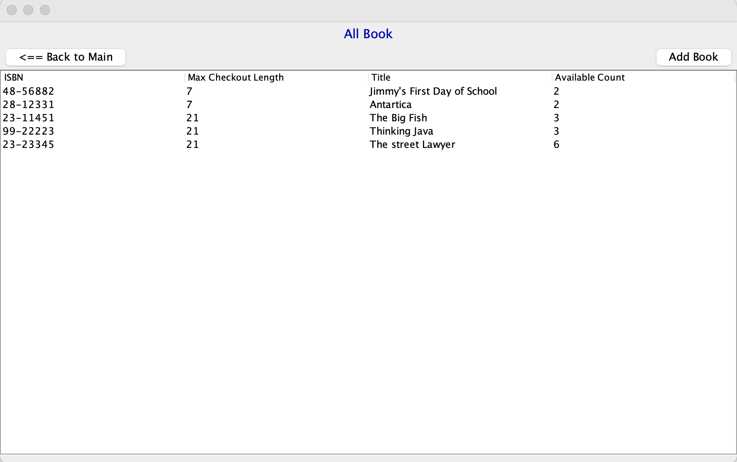

Slide 21
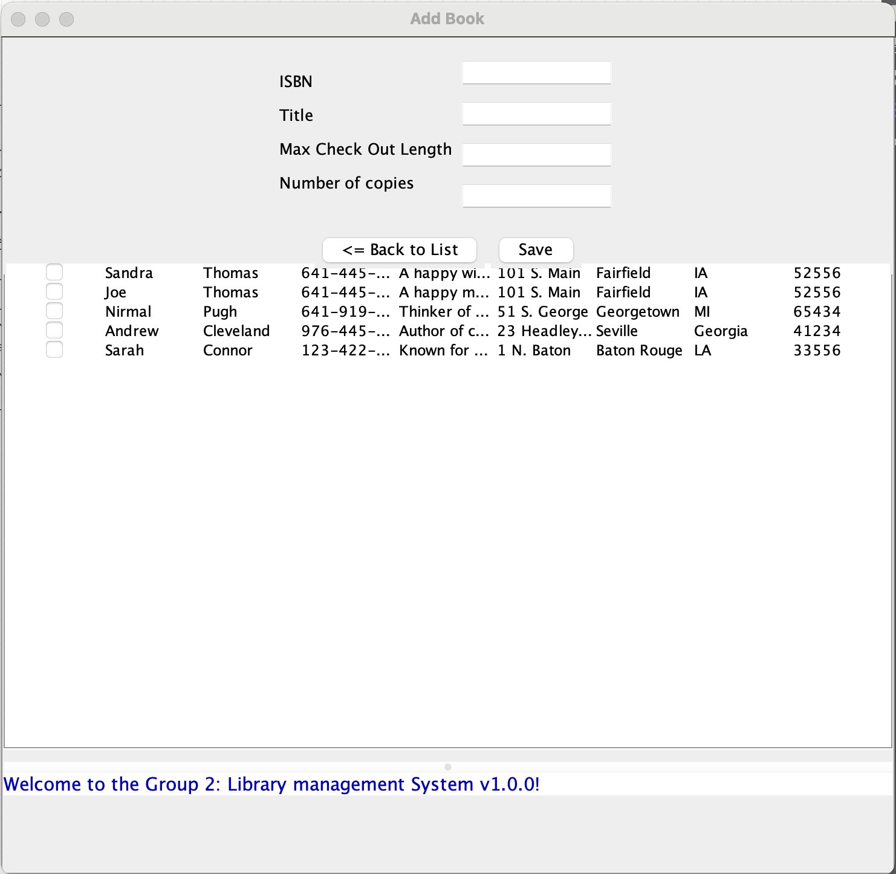
Extra Credit

Slide 22
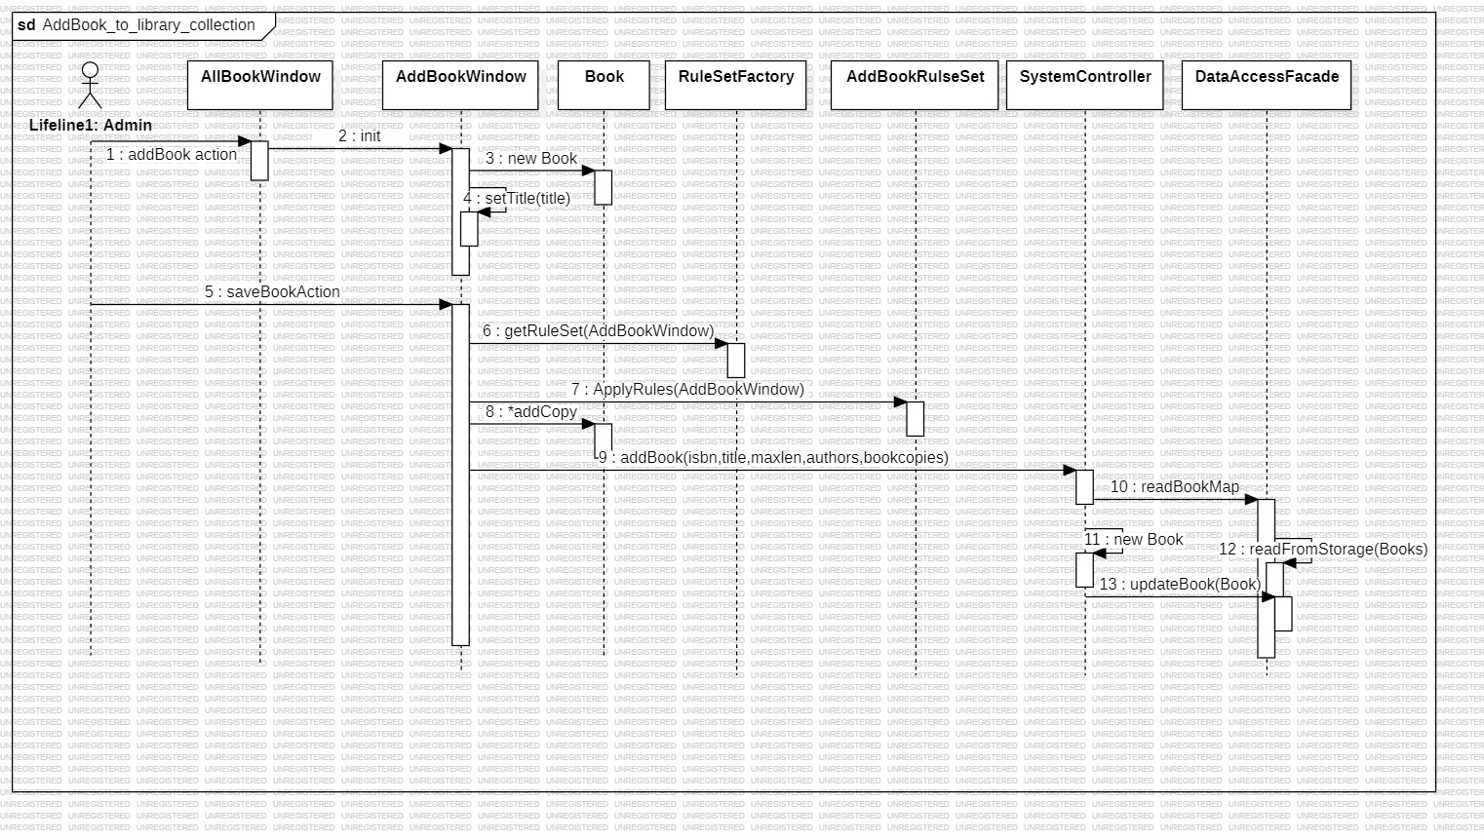

Slide 23
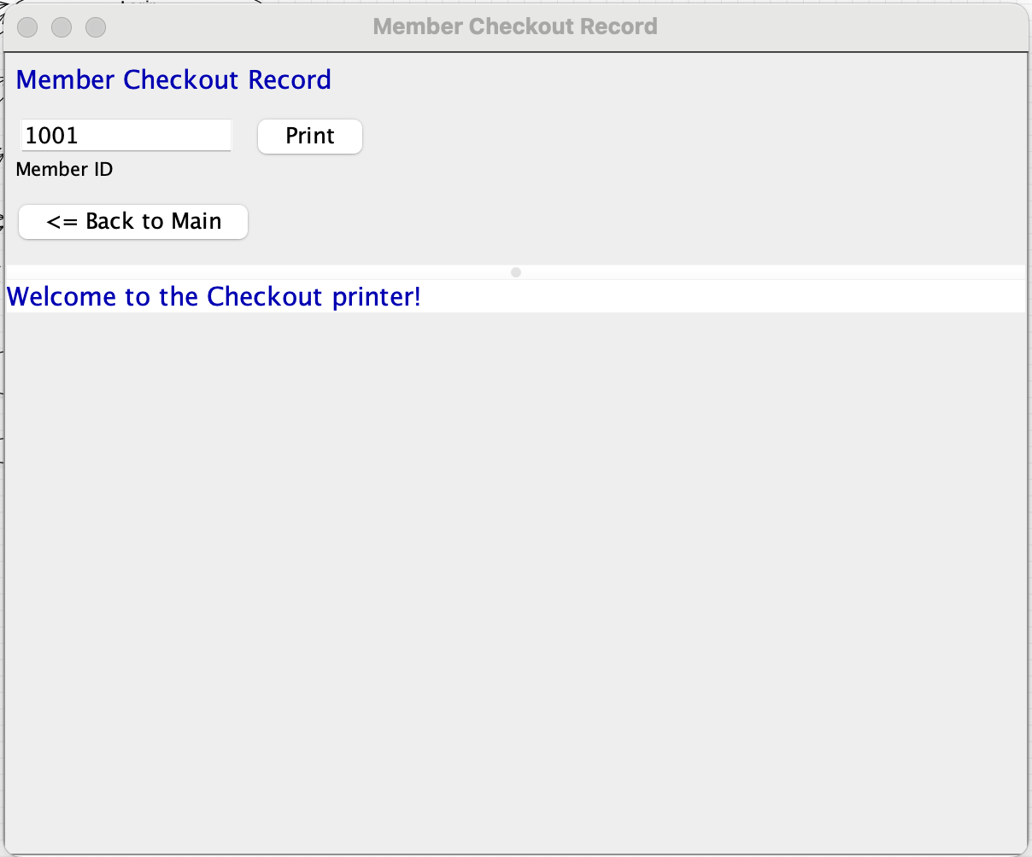
Extra Credit

Slide 24
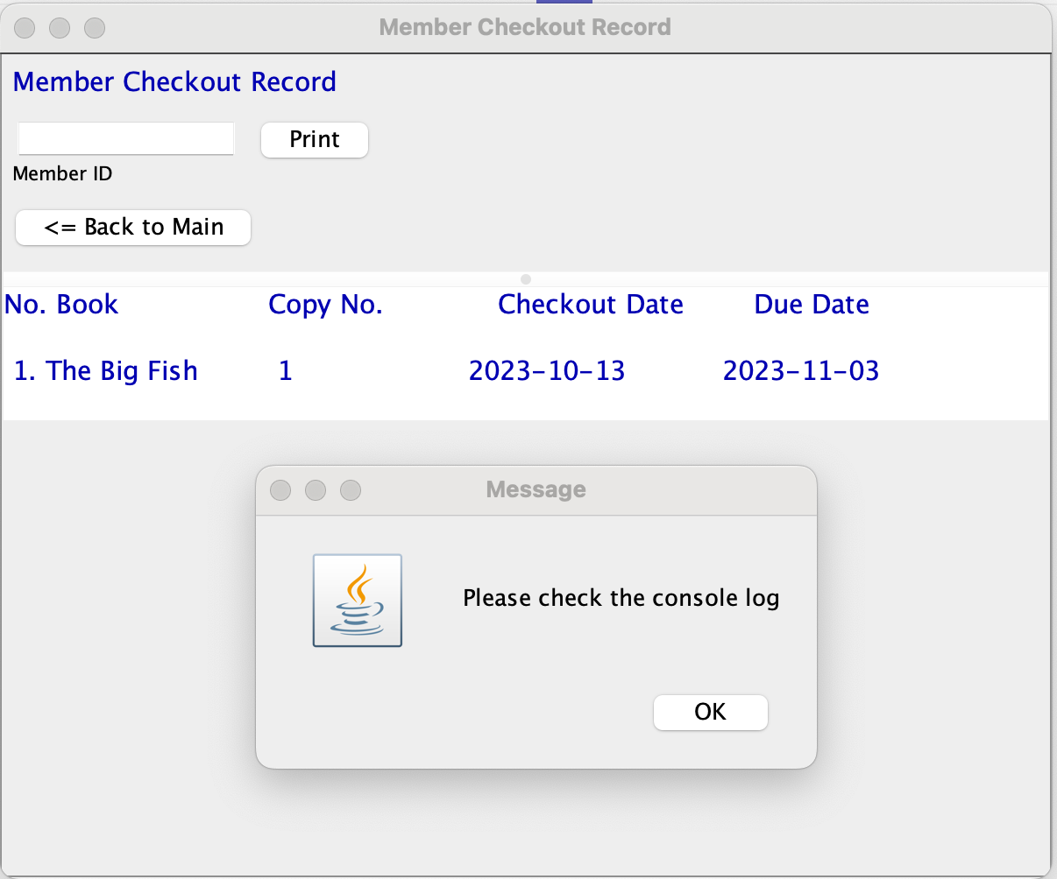

Slide 25
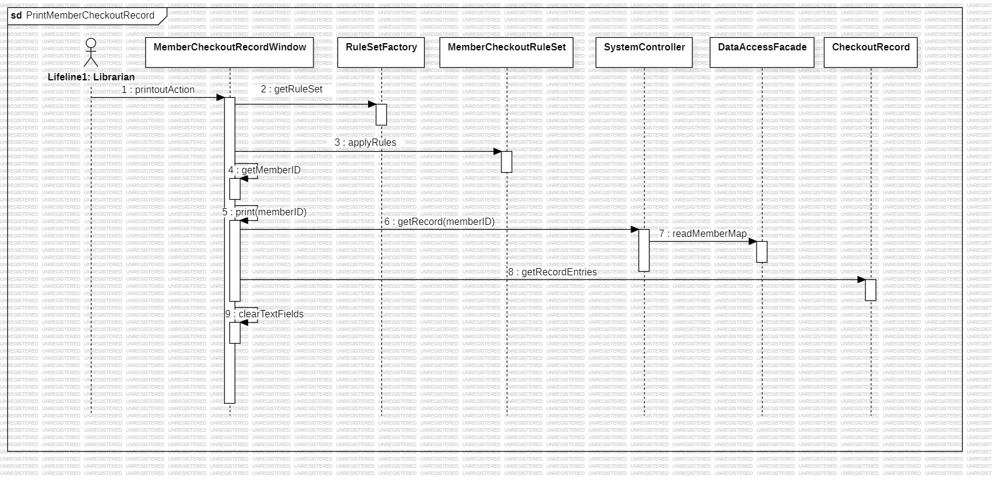

Slide 26
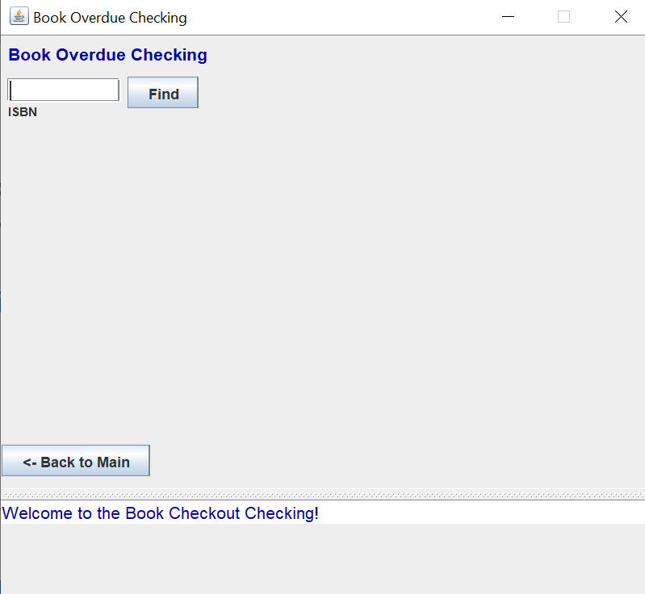
Extra Credit

Slide 27
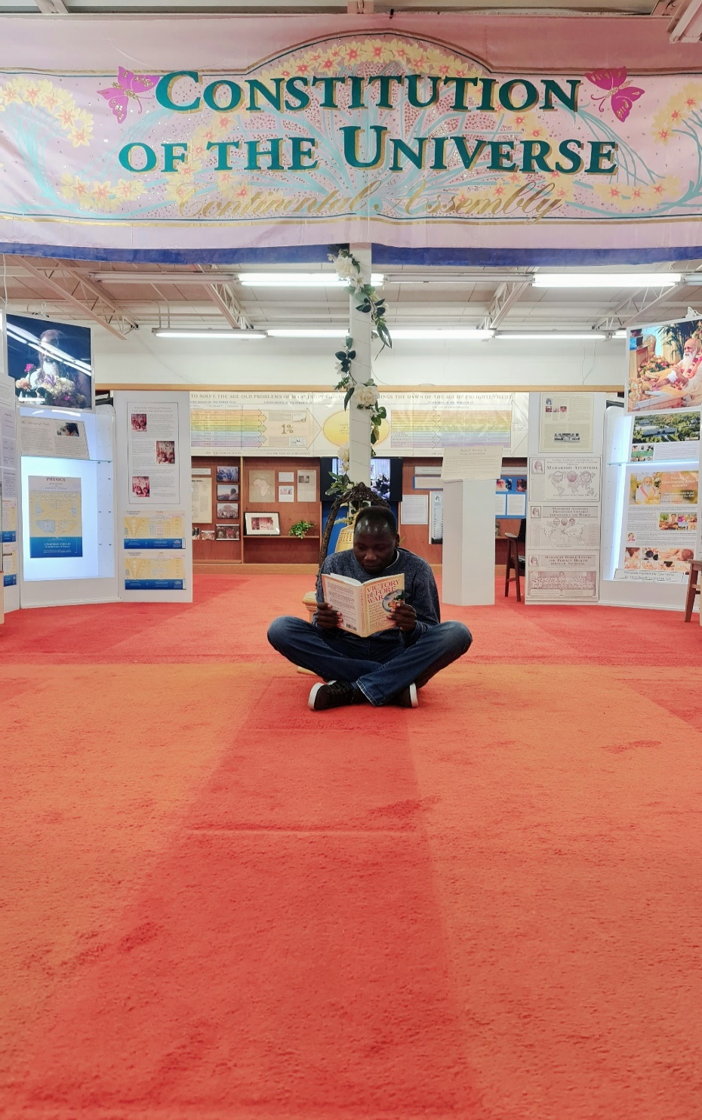
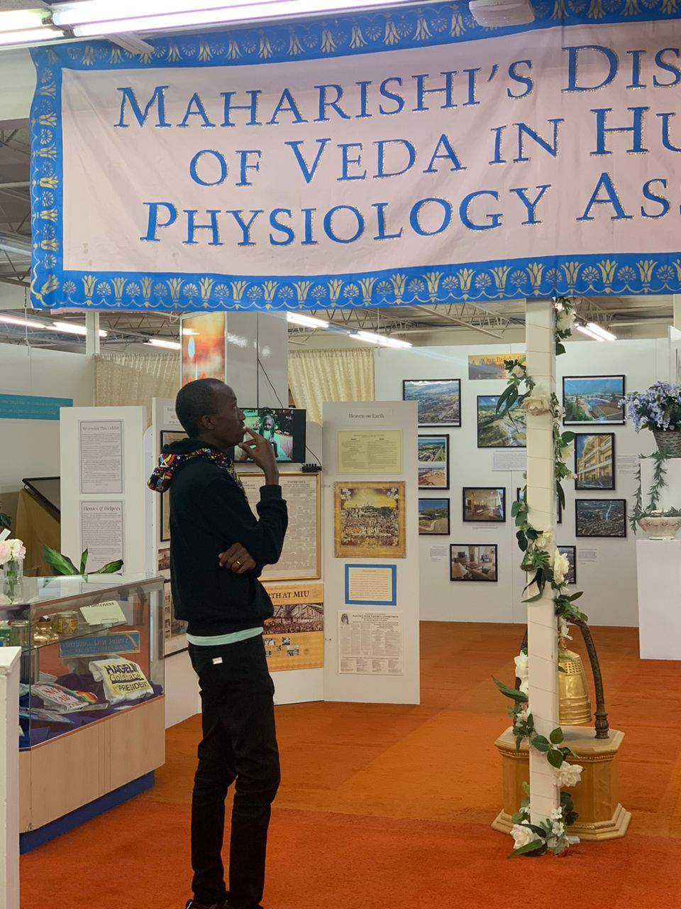
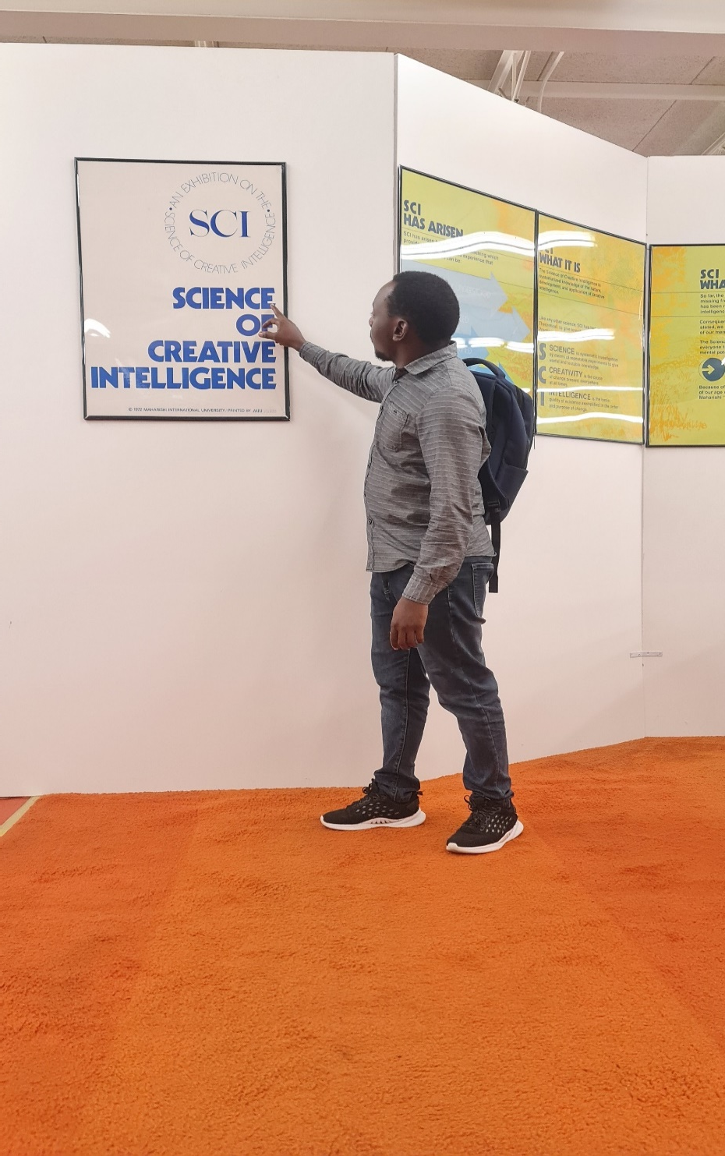
“I hold that life is bliss. In essence, life is not a struggle” – Maharishi Mahesh Yogi

Slide 28

Practice TM
Group 2 – with LOVE
Wisdom
Creativity
Unbounded Awareness

